Slide 1
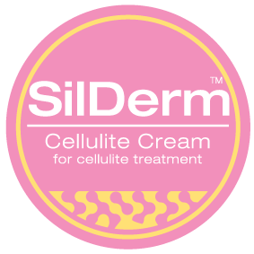
SilDerm Triple Action Anti-Cellulite Cream

Slide 2
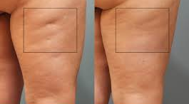
Cellulite
Cellulite in skin is caused by increase in fat deposits under the skin.
This is particularly prevalent in areas such as thighs and buttocks.
Women tend to be more susceptible as they have a higher fat content in and around the skin.
Treatment goals involve removing the fat deposits from the area leaving the skin flat and smooth.

Slide 3
Cellulite Treatment
Treatment for cellulite is focused on moving the fat deposits away from the affected area.
This can be done several ways;
Physically by intense massage in the affected area
By use of pharmacological agents that break down the fat and strengthen the skin
By use of agents that dilate the blood vessels to encourage the fat to leave the affected area

Slide 4
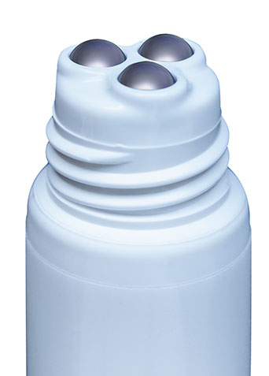
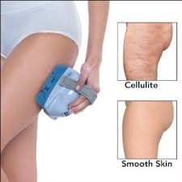
SilDerm Anti-Cellulite Cream
Massage:
SilDerm Anti-Cellulite Cream has a massage applicator that massages as the cream is applied.
This massage action helps to breakdown the fat under the skin and makes it more mobile so that it can be removed from the area and hence loose the ‘orange peel’ look

Slide 5
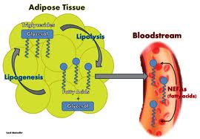
SilDerm Anti-Cellulite Cream
Fat Lypolysis:
In order to be able to move the fat out of the relevant area the fat needs to be broken down into smaller parts so that it can be taken away through the bodies blood and lymphatic system.
It is important to increase the rate of fat removal by increasing the blood flow through massage and also dilating the blood vessels themselves.

Slide 6
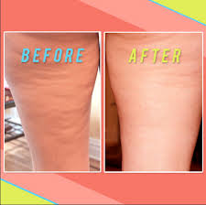
SilDerm Anti-Cellulite Cream
Skin Strengthening:
Studies have repeatedly shown that strengthening the skin around the area that is susceptible to cellulite, will decrease the orange peel look of cellulite and hence improve the overall appearance of the skin.

Slide 7
SilDerm Anti-Cellulite Cream Mode of Action
Massage
The roller ball heads massage the area, starting the process of breaking down the fat and increasing blood flow to take away the fat from the areas.
2. Fat Breakdown & Removal
Several ingredients in the cream have been proven to increase fat breakdown by more than 40%.
3. Skin Strengthening
In addition to the massage several ingredients have been shown to strengthen
the skin on application.

Slide 8
SilDerm Anti-Cellulite Cream Ingredients
2. For Fat Breakdown
Glaucine (Coco-Glucoside):
This ingredients has been proven to increase the breakdown of fat and stops the production of new fat cells.
In addition, Glaucine has been proven to decrease the fat deposits by up to one third (1/3rd).
Bupleurum chinensis Caffeine and Co-enzyme A combination:
This combination will help to decrease the orange peel effect by 33% and firm the skin in the area applied.

Slide 9
SilDerm Anti-Cellulite Cream Ingredients
3.For Skin Strengthening
Retinol:
Retinol is a Vitamin A derivative that is well known and clinically proven to thicken the epidermis when applied topically. In recent studies, Retinol has been shown to improve cellulite on its own. ¹·²

Slide 10
SilDerm Anti-Cellulite Cream Complete Ingredients
INGREDIENT (INCI) NAME | FUNCTION
Aqua | Carrier
Glycerin | Humectant
Aloe Barbadensis Leaf Juice Powder | Soothing and Moisturising
Butylene Glycol (and) PEG-8 (and) Bupleurum Falcatum Root Extract (and) Caffeine (and) Coenzyme A | Slimming Active
Algae Extract & Pullulan, Phenoxyethanol, Sodium Benzoate | Skin Tightening Active
Glycerin (and) Aqua (water) (and) Coco-Glucoside (and) Caprylyl Glycol (and) Alcohol (and) Glaucine | Skin Firming Active
Aqua, Glycerin, Citric Acid, Lactic Acid, Glycolic Acid, Malic Acid, Tartaric Acid, Citrus Medica Limonum Extract, Pyrus Malus Extract, Saccharum Officinarum Extract, Vaccinium Myrtillus Extract, Vitis Vinifera Extract | Exfoliant
Tocopherol Acetate | Stabiliser
Water & Acanthopanax senticosus (Eleuthero) Root Extract | Skin smoothing/Wrinkle Reuction
Carbomer | Gelling Agent
Algae Extract & Arnica montana (Arnica) Flower Extract | Reduces Inflammation
Butyrospermum Parkii (Shea Butter) | Emollient
Glyceryl Stearate SE | Emulsifier
Cetyl Alcohol | Emulsifier
Retinol | Epidermal Thickener
Caprylic Capric Triglycerides | Emollient
Phenoxyethanol | Preservative
EDTA | Chelating Agent
Menthol | Coolant
Citrus Nobilis (Mandarin Orange) Peel Oi | Fragrance
Triethanolamine | Ph Modifier

Slide 11
SilDerm Anti-Cellulite Cream
Market and Product Positioning

Slide 12
SilDerm Anti-Cellulite Cream Features
Triple Action Helps remove Cellulite
1- Massage
2- Fat breakdown & Removal
3- Skin Strengthening

Slide 13
SilDerm Anti-Cellulite Cream Features
Massage:
The roller ball head will massage the area breaking up the fat and increasing blood flow.
2. Fat Breakdown & Removal:
The unique plant extracts in SilDerm Anti-Cellulite Cream have been clinically proven to help the break up of the fat and help with the drainage through the blood and lymphatic system.
3. Skin Strengthening:
A combination of massage and the ingredients in SilDerm Anti-Cellulite Cream will help strengthen the skin the in the area applied, which has been proven to significantly improve the appearance of Cellulite.

Slide 14
Clinical Summaries
^{References}
¹Kligman AM, Pagnoni A, Stoudmayer T. Topical retinol im- proves cellulite. J Dermatol Treat 1999;10:119-25.
²Machinal-Que ́lin F, Dieudonne ́ MN, Leneveu MC, Pecquery R, Castelli D, Oddos T, et al. Expression studies of key adipogenic transcriptional factors reveal that anti-adipogenic properties of retinol in primary cultured human preadipocytes are due to retinol per se. Int J Cosmet Sci 2001;23:299-308.

